Slide 1
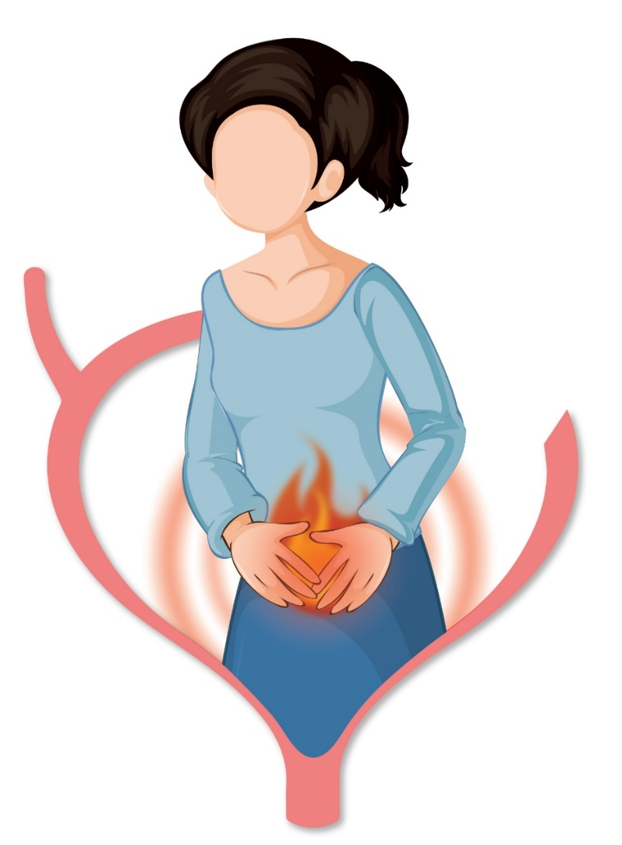
Urinary Tract Infection (UTI)
A Comprehensive Approach to Diagnosis and Care
Dr. Afroza Jahin
Executive, DMA
Nuvista Pharma

Slide 2
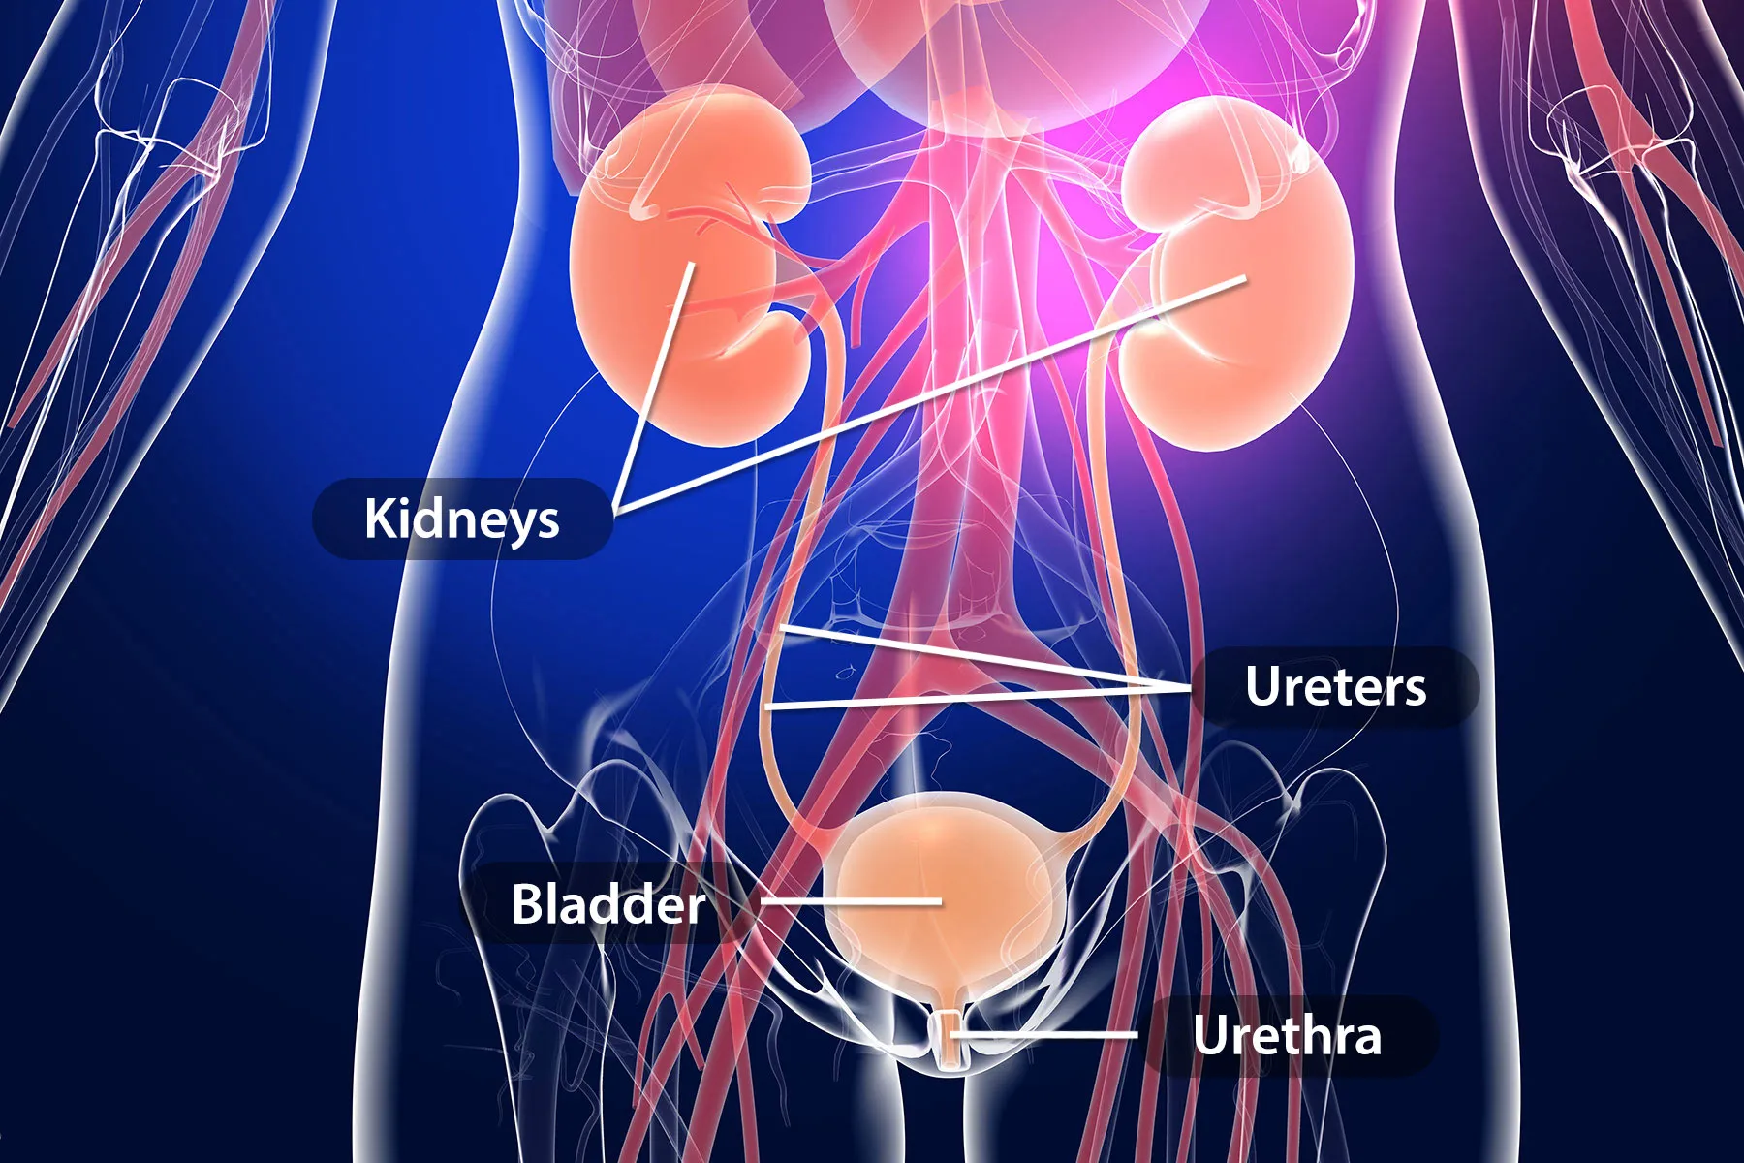
Urinary tract infection
Urinary tract infection (UTI) is a broad term that encompasses a spectrum of infectious syndromes that affect the urinary tract anywhere from the urethra to the kidneys.

Slide 3
Prevalance of UTI
UTIs are one of the world’s most common infectious diseases, affecting 150 million people each year, with significant morbidity and high medical costs .
In general, about 50 to 70% of women will have a UTI sometime during their lifetime.
20 to 30% of women who have a UTI will have a recurrent UTI

Slide 4
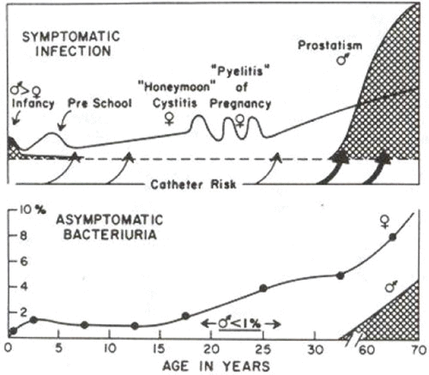
Distribution of UTI
Women are the most infected subjects in the populations.
In certain periods of life e.g. childhood, honeymoon, pregnancy and elderly, an increased incidence of UTI has been seen.
Acute pyelonephritis (upper UTI) is much less common than cystitis or lower UTI (urethritis & prostatitis)

Slide 5
Causative organisms
Urinary tract infections (UTIs) are caused by a wide range of pathogens, including Gram-negative and Gram-positive bacteria, as well as fungi.
The most common causative agent for both uncomplicated and complicated UTIs is uropathogenic Escherichia coli (UPEC).

Slide 6
Cont…
For uncomplicated UTIs, other causative agents are
Klebsiella pneumoniae
Staphylococcus saprophyticus
Enterococcus faecalis, group B Streptococcus (GBS)
Proteus mirabilis
Pseudomonas aeruginosa
Staphylococcus aureus and
Candida spp.

Slide 7
Cont…
For complicated UTIs, the other causative agents are
Enterococcus spp.
K. pneumoniae
Candida spp.
S. aureus
P. mirabilis
P. aeruginosa & GBS.

Slide 8
Symptoms of UTI
Symptoms may vary according to the site of infection.
1- Pyelonephritis (Upper UTI)-
Loin pain
Back pain
Fever with chills
Nausea, vomiting
Anorexia
Septic shock in severe cases

Slide 9
Symptoms of UTI
2- Cystitis(Lower UTI)-
Dysuria
Increased frequency
Suprapubic tenderness
Urgency
Polyuria
Hematuria

Slide 10
Classification of UTI
There are several classification systems for describing and classifying UTIs, with the common rationale that
the risks of recurrence,
progression,
chronic status, and
severe outcomes
are worse for complicated than for uncomplicated UTIs

Slide 11
Classification of UTI
The clinical spectrum of UTIs is heterogeneous and ranges from benign to life-threatening infections with important variations in both diagnosis and treatment.
On the basis of complications-
1. Complicated UTIs-
UTIs with any structural or functional abnormalities of urinary tract.
2. Uncomplicated UTIs-
UTIs without any structural or functional abnormalities of urinary tract.

Slide 12
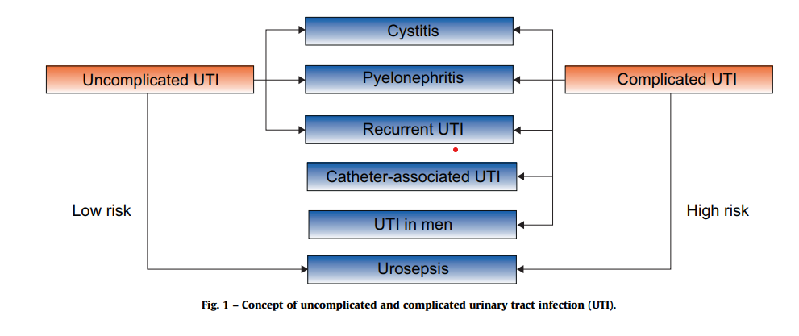

Slide 13
Asymptomatic bacteriuria
•Do not screen or treat asymptomatic bacteriuria in patients without risk factors.
•Screen for and treat asymptomatic bacteriuria before urological procedures breaching the mucosa.

Slide 14
Recurrent UTIs
Use a urine culture to diagnose recurrent UTI.
Use methenamine hippurate to reduce recurrent UTIs in women with no urinary tract abnormalities.
Use continuous or postcoital antimicrobial prophylaxis if non-antimicrobial interventions have been ineffective in preventing recurrent UTIs.

Slide 15
Complicated UTIs
Urine culture and susceptibility testing should be performed, and initial empiric therapy should be tailored and followed by (oral) administration of an appropriate antimicrobial agent for the uropathogen isolated.

Slide 16
Urosepsis
Obtain a urine culture and two sets of blood cultures before starting antimicrobial treatment.
Give parenteral high-dose broad-spectrum antimicrobials within the first hour after clinical assumption of sepsis and adapt the initial empiric antimicrobial therapy based on culture results.

